Slide 1
BONE HEADPHONES
BY:
17BCE1043 – YOKESH
17BCE1094 – SANATHAN NARAYANAN
17BCE1169 – KRISHNA MANJUNATH
17BCE1210 – PRATIKSHA RAVISHANKAR
17BCE1264 – AMRITHA T

Slide 2
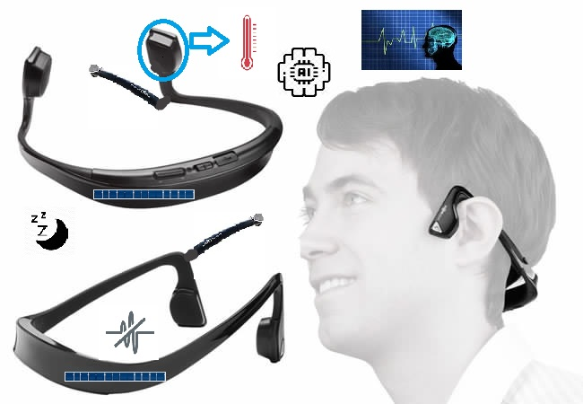
PROJECT IDEA

Slide 3
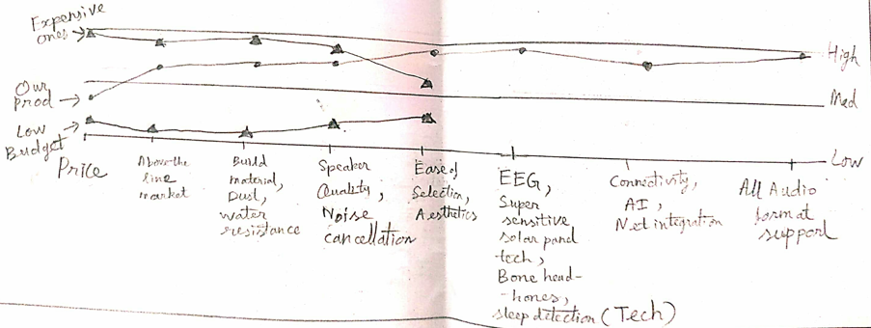
VALUE CURVE

Slide 4
ELIMINATE
ELIMINATING
traditional earpiece to replace it by specialized ones which can make both deaf & normal people hear sounds.
This reduces stress in ears as it is weightless which directly sends signals to skull through vibrations

Slide 5
REDUCE
REDUCE
We would reduce the number of different models as: the major reason why IOS is considered better than Android is that IOS have fewer types of versions
We would also produce in every nation to reduce import charges

Slide 6
CREATE
CREATE
We would add new features like:
Super Sensitive Solar Panels which keeps the headphones powered on always. So no need to charge the battery externally.
We would add EEG which can be used to detect ‘Sleep’ (through brain waves) and play loud alarm while driving at night.
EEG would also be used to detect Commands to Headphones

Slide 7
RAISE
RAISE
We would increase the following:
Improve connectivity through:
AI Integration
Advanced Wireless Connections
Faster Web Integration
Aesthetics:
Most products are not popular as they don’t look/feel good, so we make this one as our top priority.

Slide 8
SUBSTITUTE NORMAL EARPIECE
SCAMPER
Replace normal earpieces with ‘Heat Earpieces’ which are specially designed to warm themselves to maintain comfort in cold surroundings. Also includes Noise Cancellation.
COMBINE WITH SUPER SOLAR SEMNSITIVE PANELS
Super sensitive solar panels charge batteries continuously even at low light conditions using super conductors.
ADAPTING
‘Bone Headphones’ – this is useful for deaf people who can feel or literally hear sound by feeling the vibrations sent to their brain.

Slide 9
MODIFY OR MAGNIFY
SCAMPER
Using EEG, we detect sleep and beep high volume alarm to prevent sleep – useful in people driving late night. Also used in giving commands to the Headphones
PUT TO OTHER USES
Since this has Super Sensitive Solar Panels, we can also use it to charge other products
ELIMINATE SOMETHING
Eliminate traditional sweat retaining buds/cushions with chemically aided ones which do not retain sweat.

Slide 10
SCAMPER
REVERSE AND REARRANGE
We rearrange different products’ parts together to get this ‘Bone Headphones’
Ex: EEG, Temperature Sensors, Solar Panels, Safe Chemical Aids for sweat not retaining.

Slide 11
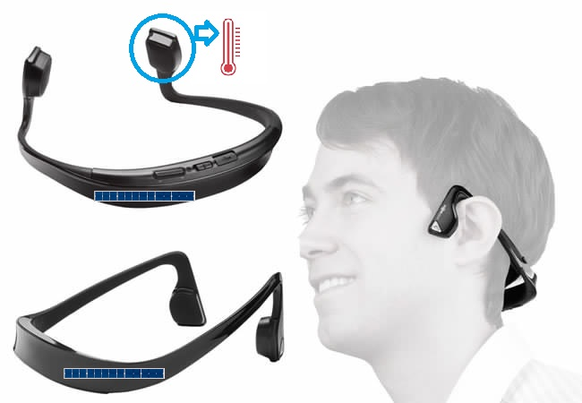
MINIMUM VIABLE PRODUCT

Slide 12
MINIMUM VIABLE PRODUCT
Can you always rely on customers to tell you their requirements?
No, as customers may not know the concept of ‘Bone Headphones’, ‘Brainwaves’, etc.
Customers may not know the importance of this product as they may be busy and may ignore questions.
They may not answer questions sincerely – highly depends on their emotional state.

Slide 13
MINIMUM VIABLE PRODUCT
Do consumers recognize that they have the problem you are trying to solve?
Yes, obviously everyone cares for people who are medically handicapped. Everyone will want to develop in medical area.
If there was a solution, would they buy it?
Yes, as for the above reasons
Would they buy it from us?
Yes, since we would be the first to do this and would produce it after extensive research. We will also do a lot of hard work in advertising area.

Slide 14
MINIMUM VIABLE PRODUCT
Can we build a solution for that problem?
Yes, after extensive research, we feel that it is easy to build the solution for “Making deaf people hear sound through our product”
Minimum Viable Product:
Bone headphones
Super Sensitive Solar Panel
Heating/Sweat Non Retaining cushions

Slide 15
RESEARCHING & FUNDING
We would follow:
Bootstrapping our business
Crowdfunding
Seek Angel Investment for our Lean Startup
Seek Venture Capital for our Lean Startup
Seeking Funds from Business Incubators and Accelerators
Source Funds by winning contests
Raise Money through Bank Loan
Acquire Loans from Microfinance Providers or NBFCs

Slide 16
RESEARCHING & FUNDING
Bootstrapping our business:
In order to succeed in your first time out in your business startup, you must ensure that you have some saved up funds you can easily access or funds you can obtain from friends or family.
The process of utilizing personal saved up funds or funding from friends and family is known as bootstrapping or self -funding.
Obtaining funding from family and friends is a unique way to kick off your startup. Friends and family are usually flexible when it comes to servicing your loan debt much more than other external sources.
So, if you approach the right friend or family member that supports your idea, you can get some, if not all the funds you require to start up your business.
Pros
- Funds can easily be accessed
- Little or no bureaucratic obstacles
- Flexible interest rates
Cons
- Bootstrapping doesn't work for large businesses; it only works for small-scale enterprises

Slide 17
RESEARCHING & FUNDING
Crowdfunding:
Modern technology has made it easier for people to share their problems on an interactive social platform. Crowdfunding platforms are basically set up for individuals to pitch their business ideas or challenges to a community of investors or people willing to support their ideas or cause.
How it basically works is that an individual makes a business pitch on the crowdfunding platform, he shares his business model and it's potential for growth. If his idea is bought by the crowd funders on the platform, they'll make a pledge to support his business model publicly and donate funds respectively.
Pros
- Crowdfunding essentially creates public interest for your business, thus running some free marketing and providing finance for your business at the same time
- Crowdfunding eliminates the intricacies involved in placing your business in the hands of an investor or a broker and wields that power to simpletons on the crowdfunding platform
- Has a potential to attract venture-capital investment as the business progresses.
Cons
- The heavy competition inherent in crowdfunding platforms can prove to be difficult if someone or people are pitching the same business idea as yours.
- If your business pitch isn't as solid as your competition, then there is a probability that your business idea will be overlooked or rejected

Slide 18
RESEARCHING & FUNDING
Seek Angel Investment for Your Lean Startup:
You might be curious if there is such a thing as Angel investment or Angel investor? Yes, there is. Angel investors are basically people with a huge amount of capital and are willing to invest it on over the edge business ideas.
Angel investors sometimes come together in groups to scrutinize business proposals, in order to select the perfect candidate to invest in.
Pros
- Angel investors offer mentorship alongside capital for startups
- Angel investors are willing to take risks on business idea as they anticipate heavy return on investment from your startup
Cons
- Angel investors provide lower investment capital to business ideas compared to venture capitalists.

Slide 19
RESEARCHING & FUNDING
Seek Venture Capital for your Lean Startup:
Venture capitals funds are managed by professionals that have a keen eye for seeking out companies with great prospects.
Their modus operandi involves them investing in a solid business rather than an equity. Once there is an IPO or acquisition of the business they are partnered with, they then pull out and seek other investments.
Pros
- Companies with astronomical growth rates such as Uber, Flipkart have a pre-designed exit strategy that enables them to reap huge profits that they can, in turn, re-invest in the growth of their company.
Cons
- Venture capitals will remain loyal to your business till they have recovered their capital and profits. This usually occurs during a slim three to five-year timeframe

Slide 20
RESEARCHING & FUNDING
Seeking Funds from Business Incubators and Accelerators:
Businesses that are just starting out can access funds provided by business incubators and accelerators.
The programs offered by them can be found in major cities across the globes.
Slight differences separate the terms "business incubators and accelerator".
Core Difference
Business incubators basically nurture business while accelerators fast-track businesses.
Pros
- Business owners receive mentorship from their investors
- Connections can be made with other startups
Cons
- During its 4-8 month lifespan, if commitment is lacking, the startup might spiral in a downward direction

Slide 21
RESEARCHING & FUNDING
Source Funds by winning contests:
Another amazing way to source for funds is through engaging in competitions or contests that requires entrepreneurs to showcase or pitch their business module against other competitors vying for the same funding for their businesses.
As a contestant, you are required to present a comprehensive and detailed business plan if you are looking to win over investor confidence.
Pros
- In the process of participating in these contests, media coverage will be allotted to your startup, thus giving you the much-needed publicity for your business startup.
Cons
- Losing contests or competitions can demoralize the faint hearted, thus causing them to abandon their plans of starting up their business.

Slide 22
RESEARCHING & FUNDING
Raise Money through Bank Loan:
Banking institutions provide financial backing on loans to individuals who approach them with a solid business plan. The business plan must be well structured to convey the modus operandi, profit forecast and estimated time of maturity.
The financial provision of banks is in two forms, they are working capital loan and funding.
Working Capital Loan
This loan is designed to traverse one full cycle of revenue generation. Stocks and debtors usually have leverage on the limit.
Funding
This process involves providing the business plan and concise information of the valuation, alongside the project report on which the loan was sanctioned.
Pros
- Large capital can be accessed by entrepreneurs
- Capital provided can fast-track the process of income generation
Cons
- High risk of Collateral loss, since it is an important requirement for loan grants

Slide 23
RESEARCHING & FUNDING
Acquire Loans from Microfinance Providers or NBFCs:
Microfinance was set up to give access to capital to small-scale entrepreneurs that lack access to conventional banking capital or loans. Individuals with poor credit ratings see microfinance institutions as a respite whenever they are out of favor by conventional banks.
Non-Banking Financial Corporations (NBFCs) give out loans to individuals who seek loans, without necessarily imposing any legality like conventional banks and credit repair services do.

Slide 24
RESEARCHING & FUNDING
Government Programs that Offer Startup Capital:
Government programs that offer startup capital are an excellent way to source funding for your business. You are required to submit a plan that can be accepted by the grant committee. Once your plan has been scrutinized and approved, you will be provided with the funds to start up your business.
Pros
- Funding from government is usually substantial in size, thus providing you with surplus capital to manage your startup
Cons
- The process of scrutiny, approval and eventual release of funds may take a lot of time due to government bureaucracy

Slide 25
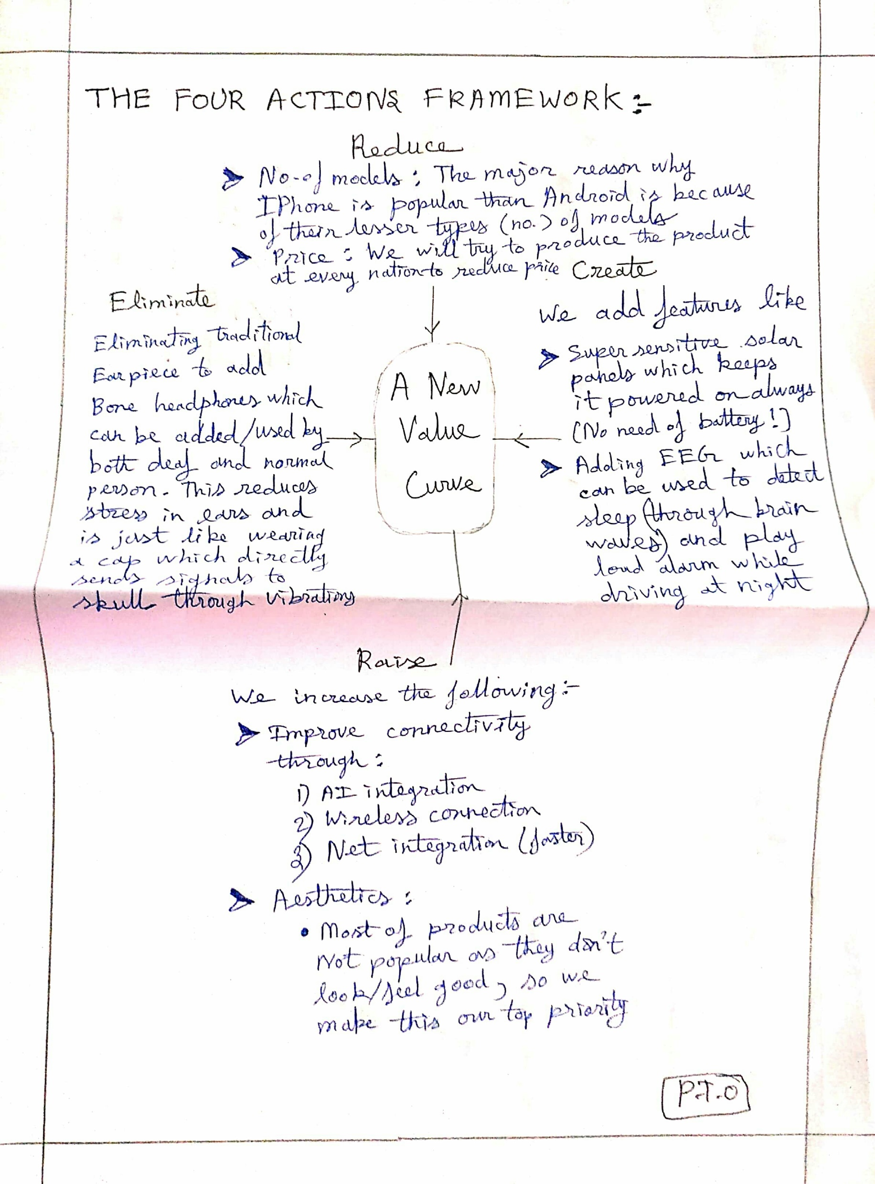

Slide 26
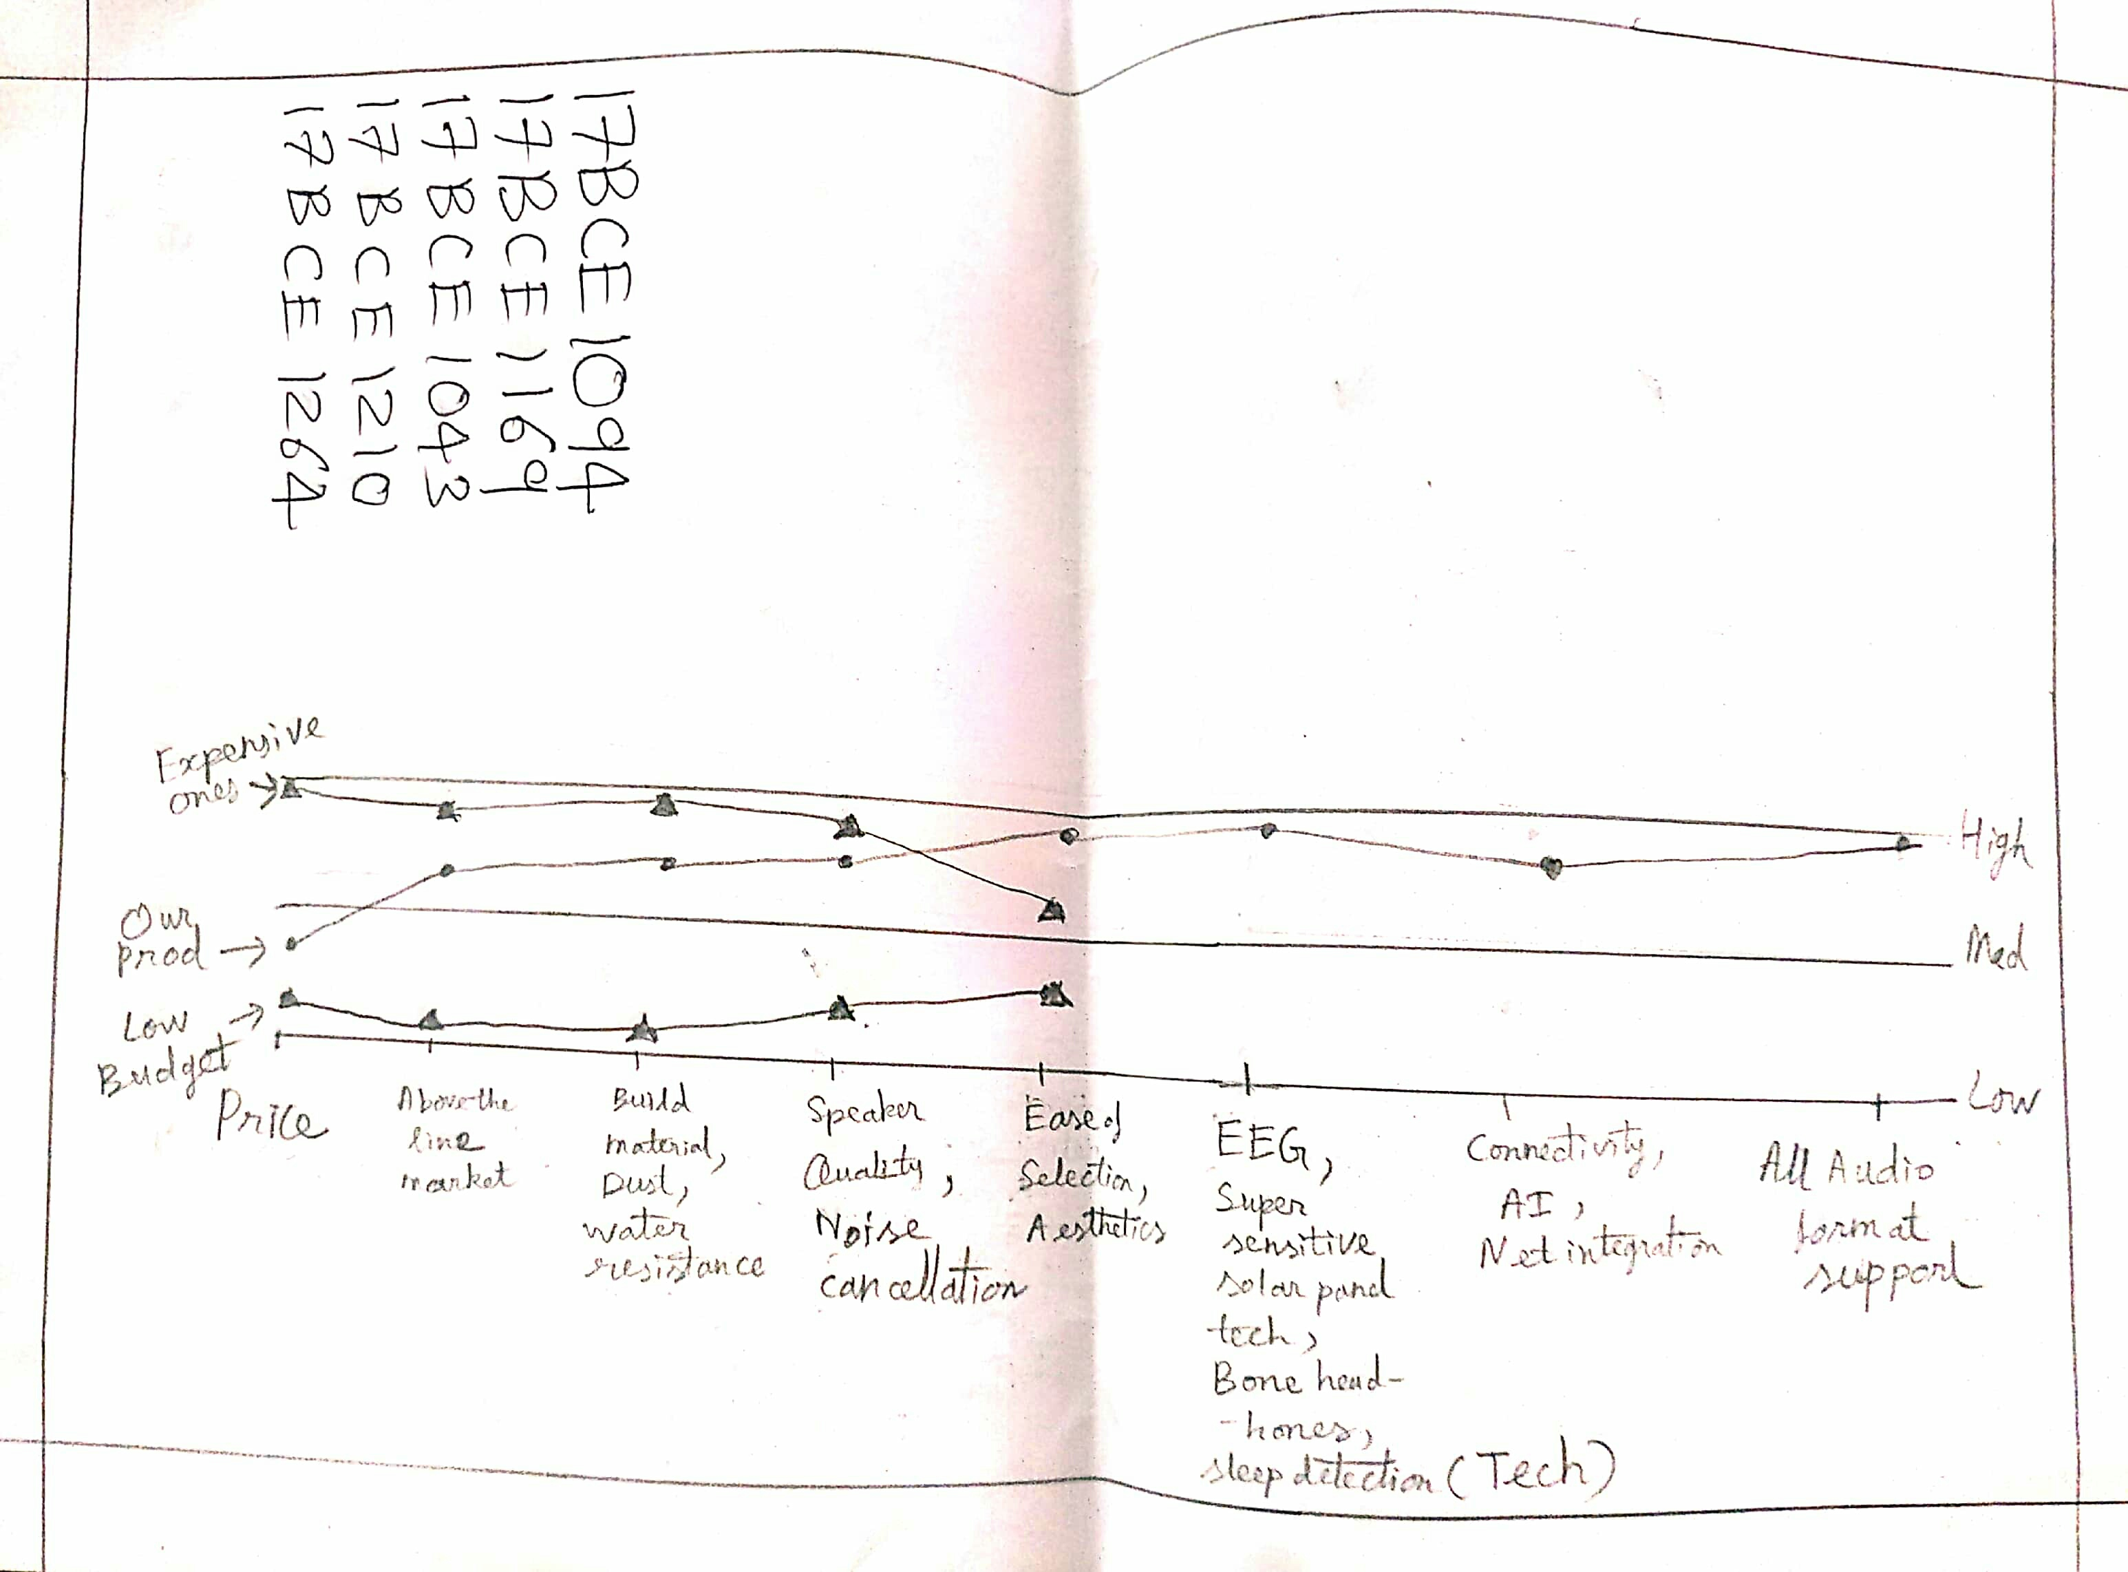

Slide 27
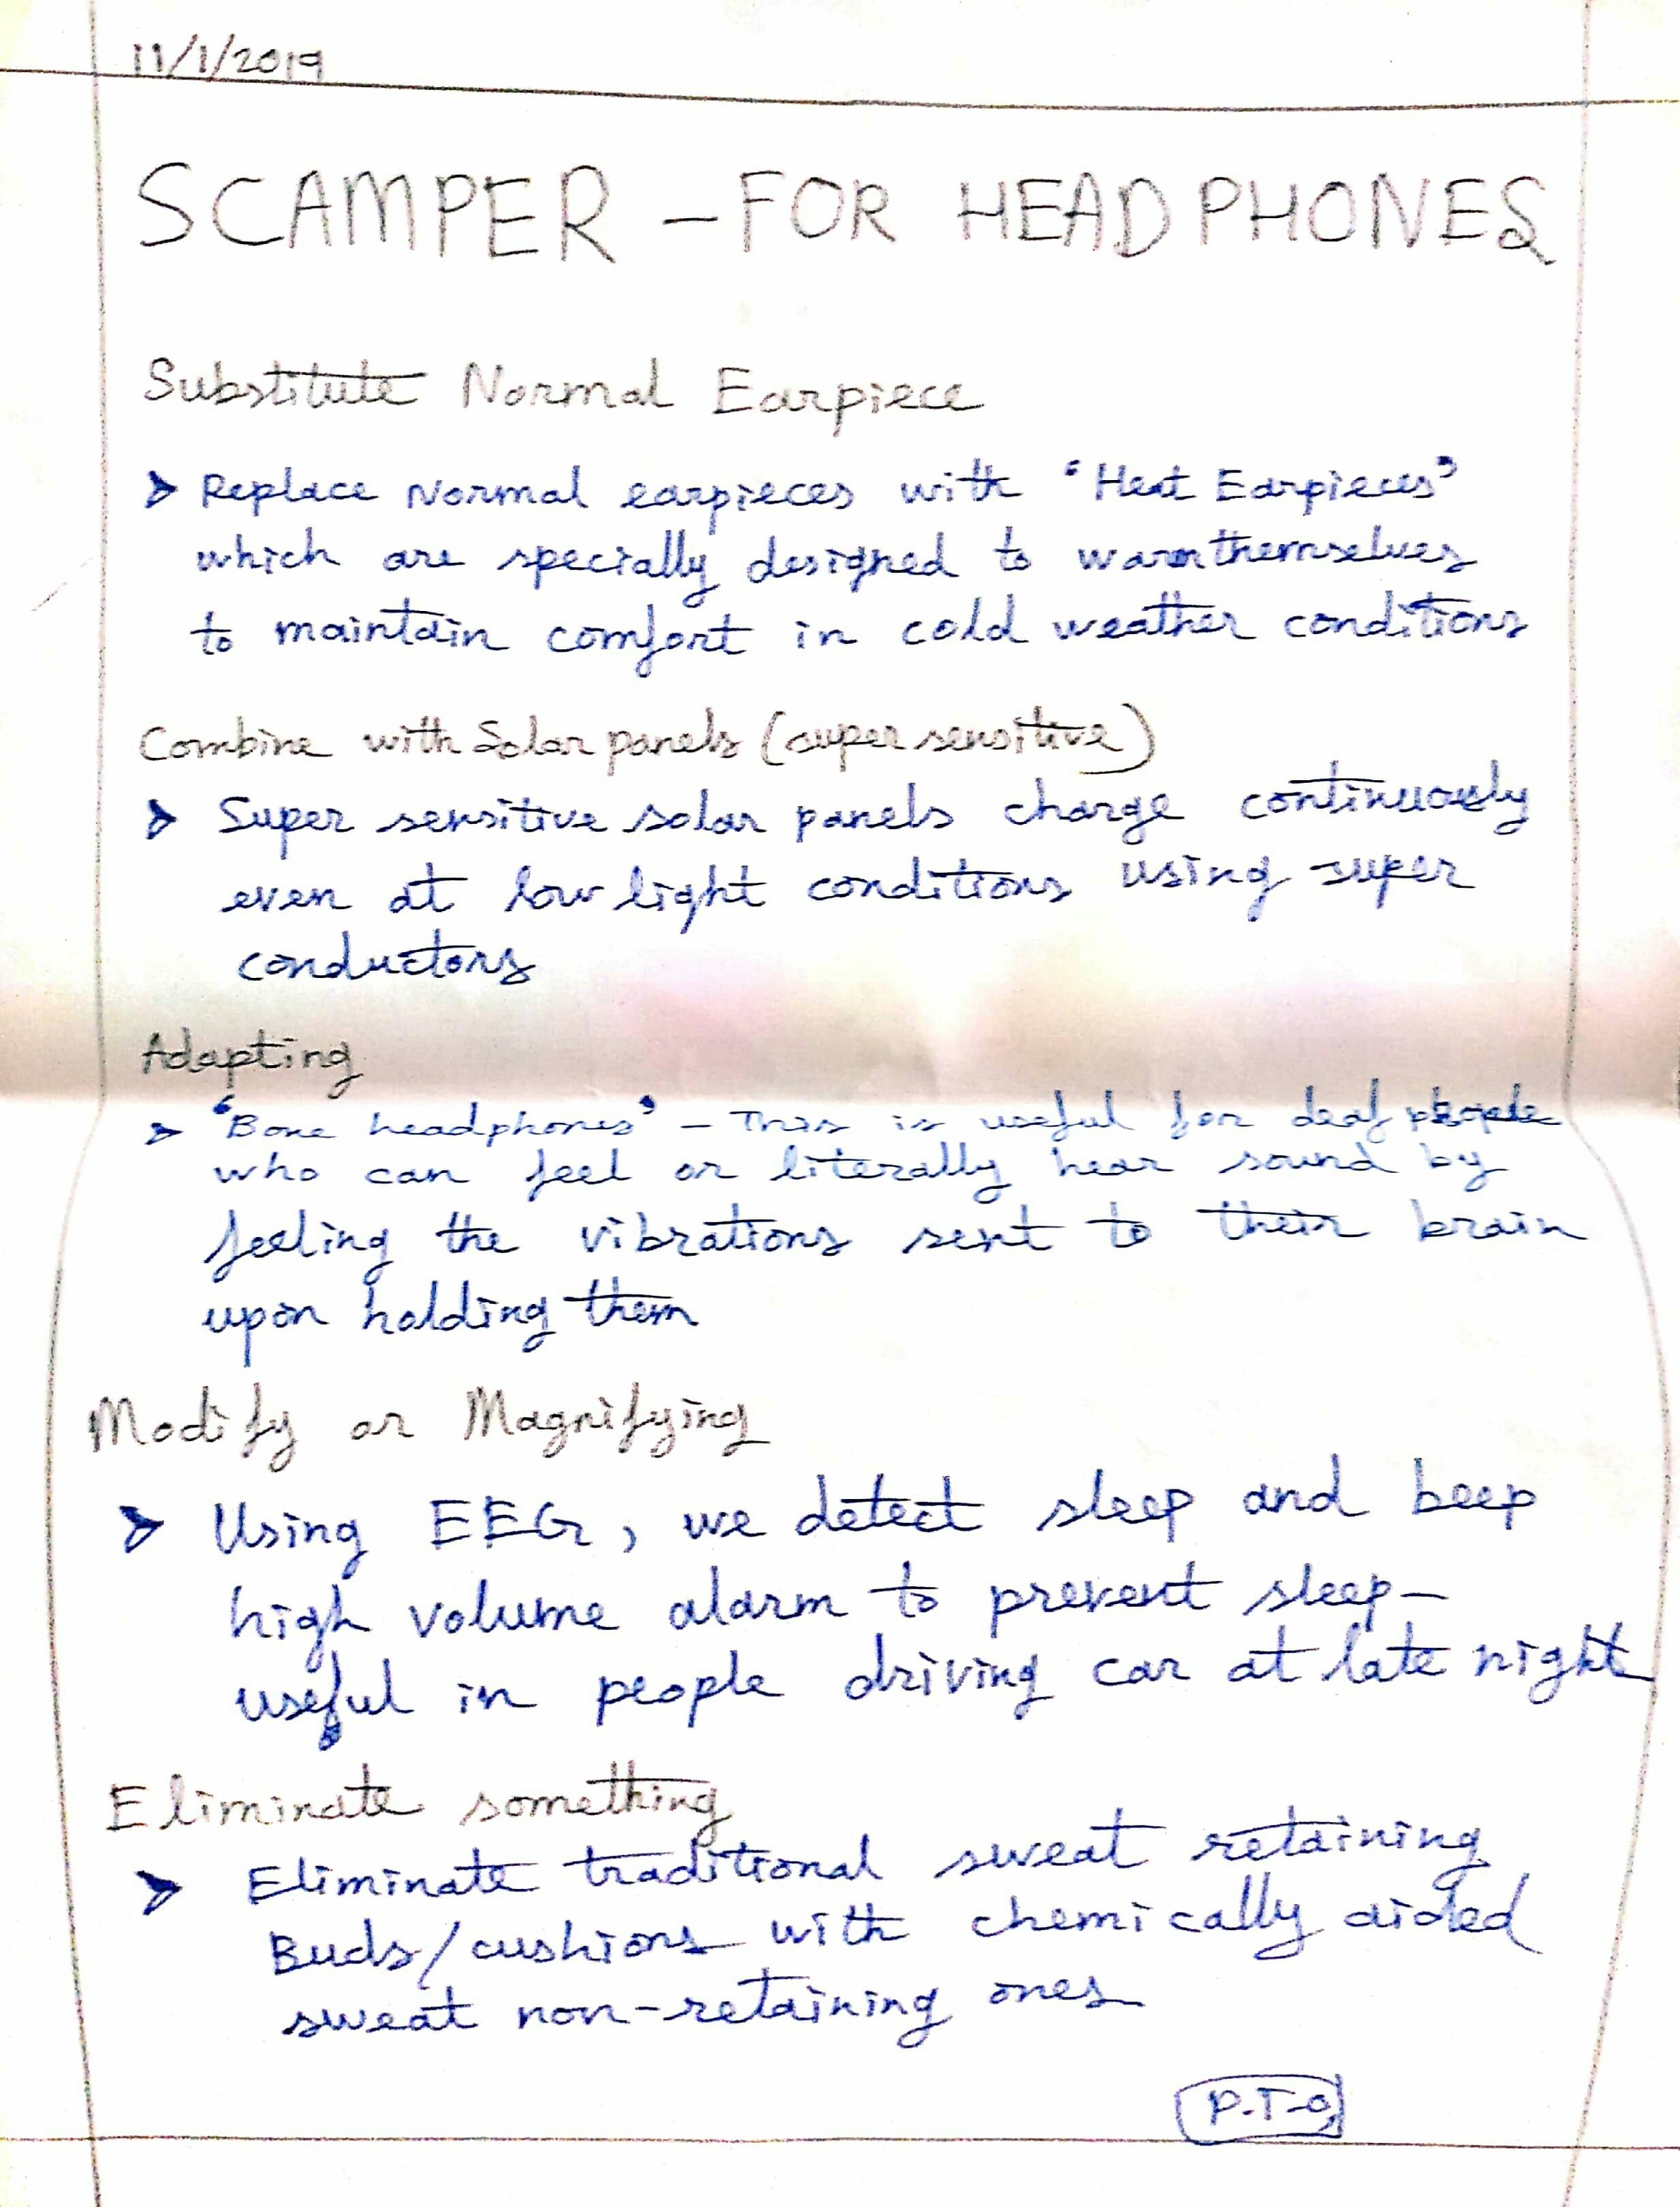

Slide 28
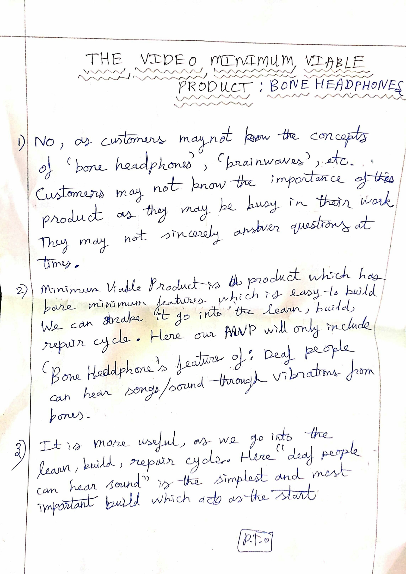

Slide 29
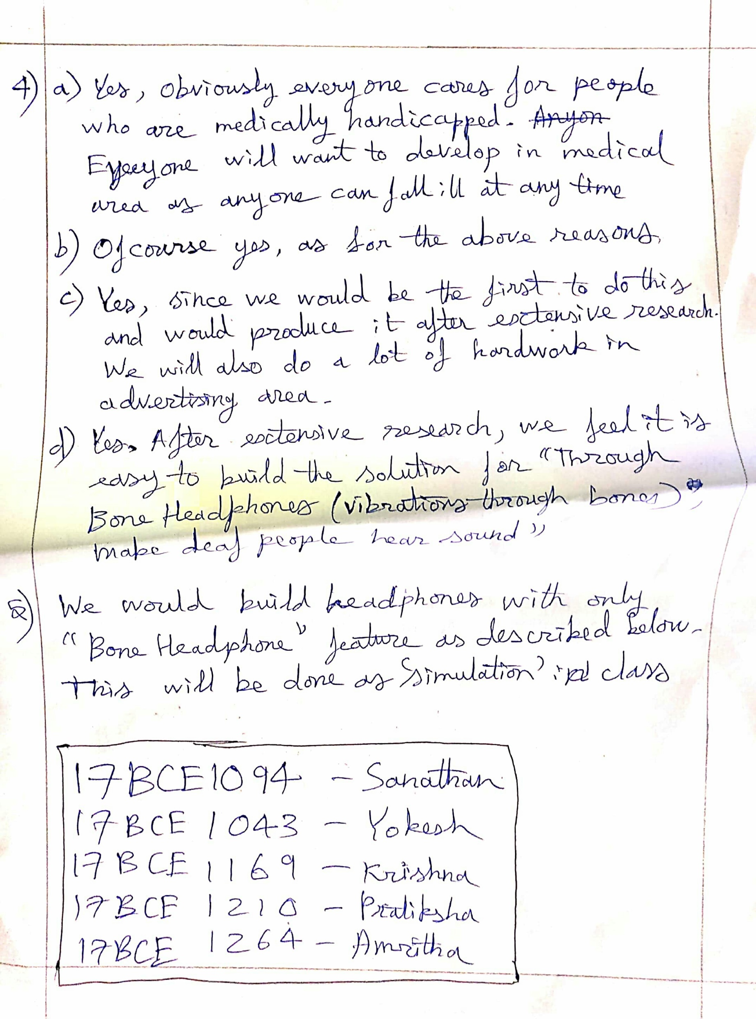

Slide 30
THANK YOU!

